Slide 1
Significant Paper Presentation
DATA-225 DB Systems for Analytics
Group 2
Bhavana Prasad Kote
Maharsh Soni
Rashmi Shree Veeraiah
Sachin Kumar Srinivasa Murthy

Slide 2
Paper Details
URL:https://ieeexplore-ieee-org.libaccess.sjlibrary.org/document/8215664
Authors: Rohit Muthyala, Sam Wood, Yi Jin, Yixing Qin, Hua Gao, Amit Rai
Conference: IEEE International Conference on Data Mining Workshops (ICDMW)
Citations: 6
Data-driven Job Search Engine Using Skills and Company Attribute Filters

Slide 3
Contents
Abstract
Design
Implementation
Key Learnings
Future Scope
Conclusion
Appendix

Slide 4
ABSTRACT
What
Why
Solution
Job seekers use job search portals to find work based on the job title, date it was posted, level of experience, company, and pay. Job platforms offer extremely constrained search criteria for skill sets based on programming languages known or company-related characteristics like revenue, relevant technologies, and tools used by companies to conduct their business and micro-industries etc.
With so many people looking for work online, having filters for specialized job searches can help job seekers and companies establish more intimate, tailored relationships. Understanding the skill sets required for a position is important for individuals since it affects their decision to advance with professional certifications to get in-demand industry-relevant competencies.
A system that offers an all-encompassing "Data-driven Jobs Search Engine" with detailed search parameters, user skill set-focused criteria, and multiple company characteristics. Additionally, job seekers can get connections to hiring managers and senior positions for networking opportunities.

Slide 5
Design

Slide 6
From Indeed, Company job pages, and professional social networks.
Use the API to merge with the Everstring Data and get insightful information.
Normalization and data cleaning. Get the domain name from the business name
Perform analysis on the data
Data collection
ETL
Data Cleaning & storage
Ranking
Extraction using API
Querying
Analytics
Extract valuable data tokens and store in a distributed database.
Identify and rate the skill set needed for a position.
To obtain relevant job listings in ranked order, run user-specific database search queries.

Slide 7
EverString Data
EverString's proprietary database of company attributes enables the search interface to cater to the user's preferences much more effectively.
Everstrings' APIs enhance the user experience and search capability by providing additional contextual features at the company level.
Utilizing APIs, integrate Everstring Data for useful insights.

Slide 8
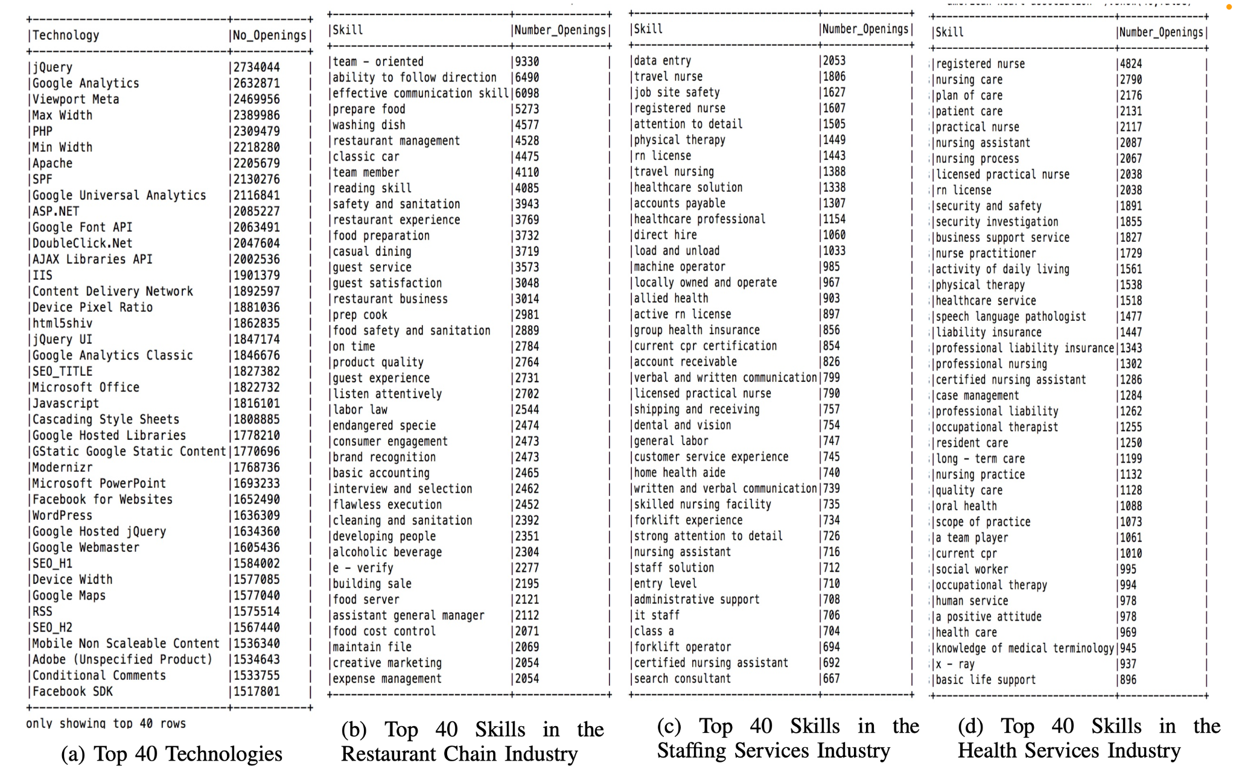
Analytic 1:
Figure (a) shows the top 40 technologies across all job postings.
Figure (b) shows the top 40 skills that restaurant chains are seeking.
Figure (c ) shows the top 40 skills that companies in the staffing services industry seek.
Figure (d) shows the top 40 skills that companies in the health services industry need

Slide 9
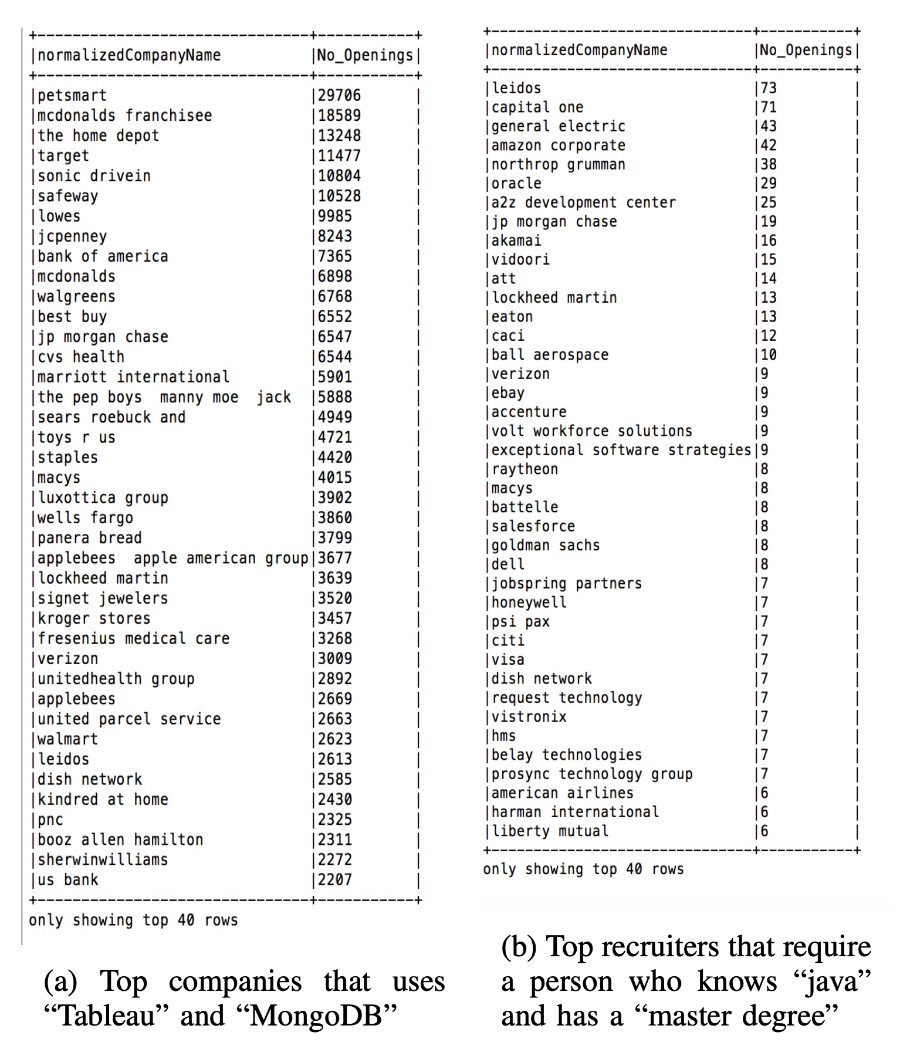
Analytic 2:
Figure (a) shows a list of top companies that use Tableau and MongoDB technologies.
Figure (b) shows companies that hire people with masters degrees and Java programming skills.

Slide 10

Key Learnings
Skill Gap
Limitation
Framework
The rich skill set and company attribute preferences that job applicants require to locate the ideal positions tailored to their particular preferences, competencies, interests, and goals are not prevalent in the current job search platforms. This offers us the opportunity to consider potential solutions for the job search platform's shortcomings.
Developing a framework that may be combined with extensive search filters, such as qualities that are centered on user skill sets and other company attributes, to create a highly customizable and highly targeted search experience for end users using data.
The significant discrepancy between what businesses demand and what students expect from their jobs and the mismatch between what instructors considered to be necessary skills and what potential employers desired shows the importance of having a system to overcome this skill gap with the help of data.
Notes:
There is significant skill gap between business demand and job seeker’s expectations.
This is limited to particular preferences, competencies, goals and interest. And we see the opportunity here.
They developed a framework that perform do extensive searching based on skillsets and company’s demand.

Slide 11
Future Scope
Trend Analysis
Granularities
Derived attributes
Track job data over time to find patterns in the skill set required for various industries and improve analytics with a temporal element.
Further filtering for social characteristics that describe a company's online social presence.
A combination of social presence and advertising technologies factors can be used to produce a higher level attribute like "Marketing Sophistication."
Notes:
Pattern analysis will be used to improve analytics
More filtering will be done on the basis of social characteristics
Collaboration with advertising agencies to improve job seeker’s experience.
My teammate rashmi will take it further..

Slide 12
Conclusion
The paper evaluated an approach that enriches a candidates' job-searching experiences by including skill set and company attribute filters.
This can be further developed in our project taking into account additional granularities, like filtering based on firm, industry and location-level information.
A relevance score derived from a weighted combination of skill sets and external company criteria is used to rank the filtered vacancies, and an extensive data analysis is also performed.
The solution enables job seekers to narrow down their search for employment by filtering on pertinent skill sets, technologies, employee count, micro industries, and several other characteristics.

Slide 13
APPENDIX
Rubric Criteria | Slide Reference
Key Learnings Students summarized what they learned and the learnings are substantial | ETL, HDFS, Big Data, Concepts of Normalization
Topic and contents of the paper Are the contents relevant and significant to the course work? | Yes, the contents of the paper are relevant to the course. Slide 6,7,8,9,10
Source of the Significant Paper Is it from a reputed journal or conference? | Yes, paper is from IEEE. Slide 2
Relation to Project Did the project build upon the significant paper? | Yes, our proposal suggests a method for delivering data-driven information to job seekers that improves their job search experience.

Slide 14
Thank you
Have any questions ?

Slide 15
References
https://financesonline.com/candidate-experience-statistics/
https://www.hercjobs.org/2022-herc-job-seeker-survey-results-higher-ed-jobs/

